Slide 1
Lecture 6: Time Response
Time response determination
Review of differential equation approach
Introduce transfer function approach
MATLAB commands
Simulation
Simulink commands

Slide 2
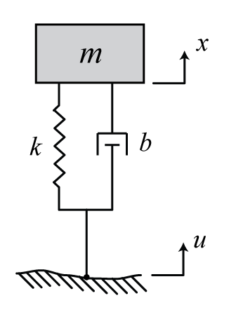
Time Response
Consider the following simplified model of a car suspension
Would like to determine the time response of the car body (x(t)) for different road inputs (u(t))
quarter mass of the car
the suspension
tire stiffness and damping
of the tires are neglected

Slide 3
Time Response
Differential equation model can be solved for different forcing inputs
Example: Driving over a bumpy road u(t) = sin(t)
Example: Driving over a curb u(t) = 1(t)
(use property of superposition to solve)

Slide 4
Example
Can also model with a transfer function

Slide 5
Time Response
The transfer function for this example is
The time response x(t) can be determined for different inputs u(t) (and zero initial conditions) using the transfer function
In general,

Slide 6
Example (step response)

Slide 7
Example (continued)

Slide 8
Example (continued)
Determine final value:
Determine frequency of oscillation:
Estimate how long it takes before response stays within 2% of its final value:

Slide 9
MATLAB Notes

Slide 10
Numerical Simulation
The models we have developed so far are linear and may be solved analytically
Many real systems include nonlinear elements such that their equations of motion are difficult if not impossible to solve
These systems can be approximated by linearized equations, or the solution to the nonlinear equations can be approximated numerically

Slide 11
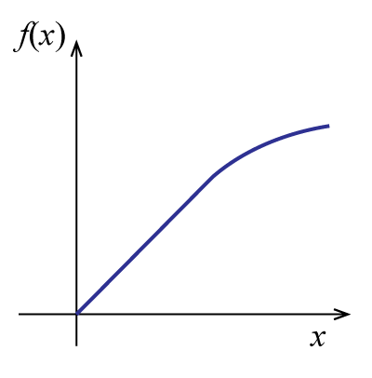
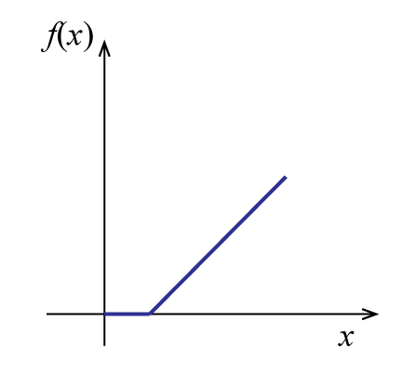
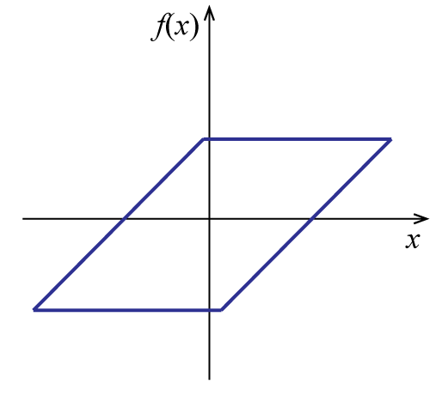
Numerical Simulation
Example nonlinearities include:
Wind drag, nonlinear springs, Coulomb friction
saturation
dead zone
backlash

Slide 12
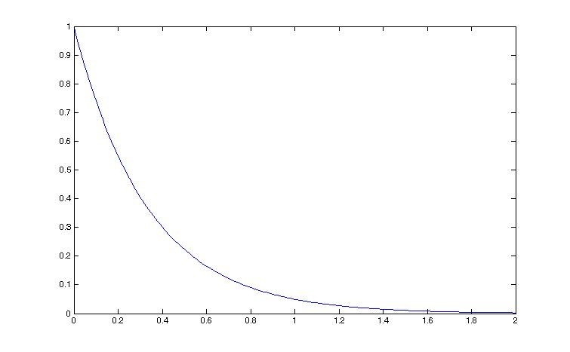
Numerical Simulation
A simple numerical
approximation employs
Euler’s method
x₀
x₁
x₂
t₀ t₁ t₂ t₃ t_{4 …}

Slide 13
Numerical Simulation
Example:
Therefore, for x(0)=1
and Δt=0.5
x₀
x₁
x₂
t₀ t₁ t₂ t₃ t_{4 …}

Slide 14
Numerical Simulation
Accuracy can be
improved by:
Reducing the
time step Δt
Using a higher-
order solver
Tradeoff between
accuracy and speed
x₀
x₁
x₂
t₀ t₁ t₂ t₃ t_{4 …}

Slide 15
Numerical Simulation
Tradeoff between accuracy and run time
Time step and solver order
Complexity of models
Some dynamics may be neglected (treated as static)
Some complex components may be represented by look-up tables and maps based on steady-state performance or cycle-averaged efficiencies
Most simulations will use some combination of physics-based dynamic models and empirical maps
Form determined by purpose and requirements

Slide 16
Numerical Simulation
We will use Simulink to perform our simulation
Simulink represents models as block diagrams and an underlying solver, like Euler’s method, is used to approximate the values of variables
Can choose solution method and time step
Simulink library includes many types of nonlinearities

Slide 17
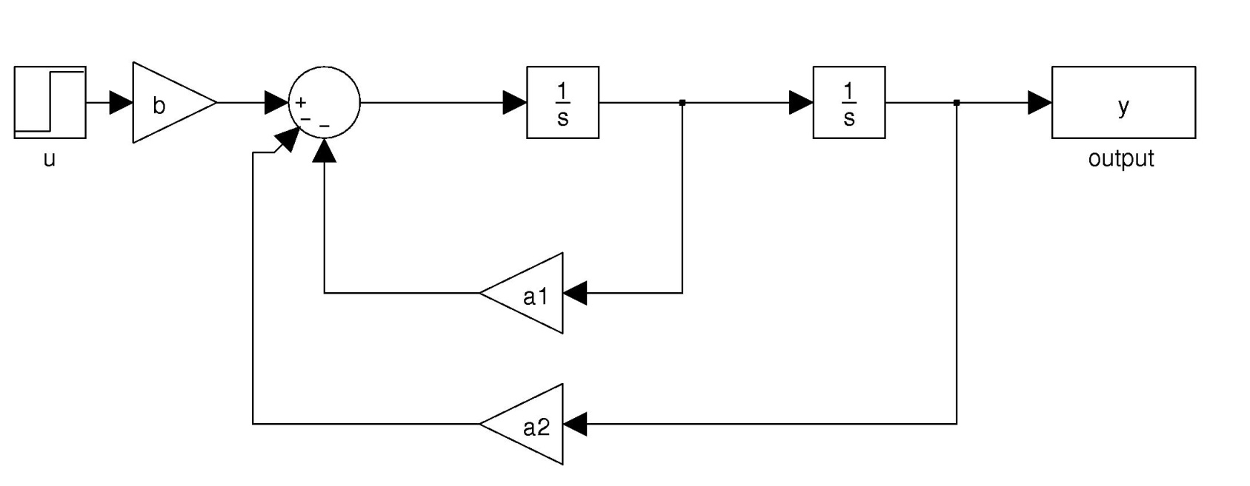
Example
Initial conditions can be set in the integrators
Can include nonlinearities

Slide 18
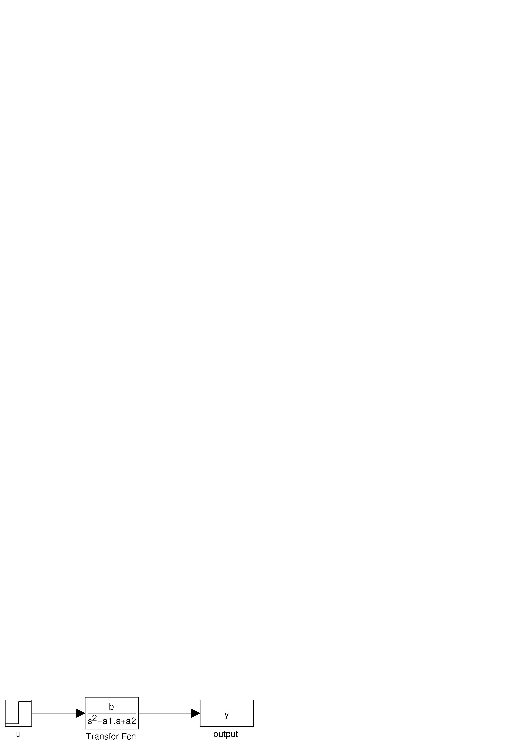
Example
Can also represent as a transfer function
Preferred for combining subsystems
Cannot set initial conditions
Cannot represent nonlinearities

Slide 19
Simulink Notes

